Slide 1
College Complaint & Issue Management System
College Complaint and Issue Management System
Grena Panchal, Manav Bhatt
Guide: Dr. Nilima Shah
Department of Applied Mathematics
The Maharaja Sayajirao University of Baroda
The Maharaja Sayajirao University of Baroda | April 2026

Slide 2
College Complaint & Issue Management System
Introduction
For complaining, Many colleges still rely on manual methods like registers or verbal communication, which often leads to inefficiency and lack of transparency. To address this, a “College Complaint & Issue Management System” has been developed as a web-based platform. It allows students to register, log in, and submit complaints online.
The Maharaja Sayajirao University of Baroda | April 2026

Slide 3
College Complaint & Issue Management System
Purpose
The project’s purpose is to provide a fast, reliable, and transparent way for students and staff to submit and manage complaints online. It replaces the slow, manual process that often leads to mismanagement, data loss, and poor communication. Users can register, submit complaints from anywhere, and track their status, while administrators can view, manage, and resolve them efficiently. The existing manual system suffers from lost or ignored complaints, lack of tracking, delays, and poor transparency. Overall, the new system reduces workload, saves time, and ensures better communication and record-keeping.
The Maharaja Sayajirao University of Baroda | April 2026

Slide 4
College Complaint & Issue Management System
Scope
The scope of this system is limited to internal college operations. It includes managing complaints related to classrooms, laboratories, library services, campus safety, and administrative departments.
The system supports complaint tracking, status updates, and record maintenance to improve communication between users and college authorities..
The Maharaja Sayajirao University of Baroda | April 2026

Slide 5
College Complaint & Issue Management System
Platform and Tools Used
Frontend:
HTML – Structure of web pages
CSS – Styling and design
JavaScript – Interactivity
React.js – Dynamic UI
Backend:
Node.js – Server-side logic
Express.js – API handling
Database:
MySQL – Store user & complaint data
Server:
Apache – Hosting the application
The Maharaja Sayajirao University of Baroda | April 2026

Slide 6
College Complaint & Issue Management System
System Analysis
Study of existing complaint system
Current system is manual (register/verbal)
Complaints may get lost or ignored
Difficult to manage records manually
The Maharaja Sayajirao University of Baroda | April 2026

Slide 7
College Complaint & Issue Management System
Problems in Existing System
The major problems of the existing system include:
No proper tracking mechanism
Delays in complaint resolution
Complaints recorded in physical registers
Complaints may be ignored or misplaced
Lack of transparency for students
The Maharaja Sayajirao University of Baroda | April 2026

Slide 8
College Complaint & Issue Management System
Solution
Online complaint submission and tracking
Centralized database for secure storage
Clear communication between users and admin
Efficient and transparent complaint handling
The Maharaja Sayajirao University of Baroda | April 2026

Slide 9
College Complaint & Issue Management System
Feasibility
Technical: HTML, CSS, JS, Node.js, MySQL
Operational: User-friendly, no training needed
Economic: Low cost using open-source tools
The Maharaja Sayajirao University of Baroda | April 2026

Slide 10
College Complaint & Issue Management System
Software Requirements
Frontend: HTML, CSS, JavaScript, React.js
Backend: Node.js, Express.js
Database: MySQL
Server: Apache
The Maharaja Sayajirao University of Baroda | April 2026

Slide 11
College Complaint & Issue Management System
Functional Requirements
Students: Register, login, submit/view complaints
Staff: Login, view/update complaints, generate reports
System: Store data, maintain history, secure login
The Maharaja Sayajirao University of Baroda | April 2026

Slide 12
College Complaint & Issue Management System
Non-Functional Requirements
Performance: Fast response, multi-user support
Security: Secure login, data protection, role-based access
The Maharaja Sayajirao University of Baroda | April 2026

Slide 13
College Complaint & Issue Management System
System Design
The working of the system can be explained in the following steps:
User Login
+
Submit Complaint
+
Complaint Stored in Database
+
Staff Reviews Complaint
+
Staff Updates Status
+
User Views Updated Status
This workflow shows how data moves from user to admin and back to the user.
The Maharaja Sayajirao University of Baroda | April 2026

Slide 14
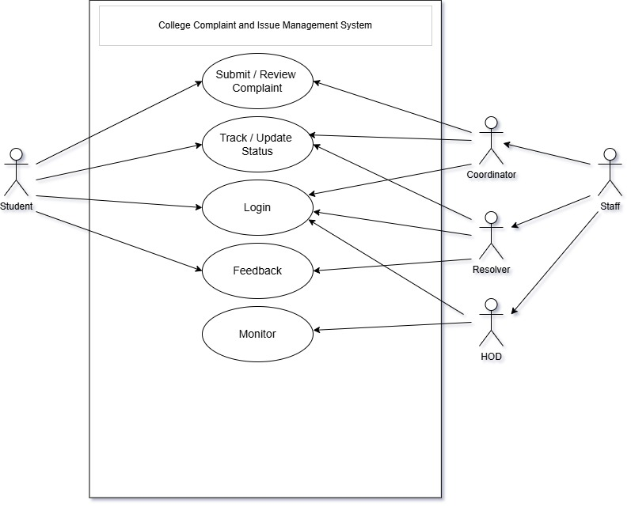
Use Case Diagram

Slide 15
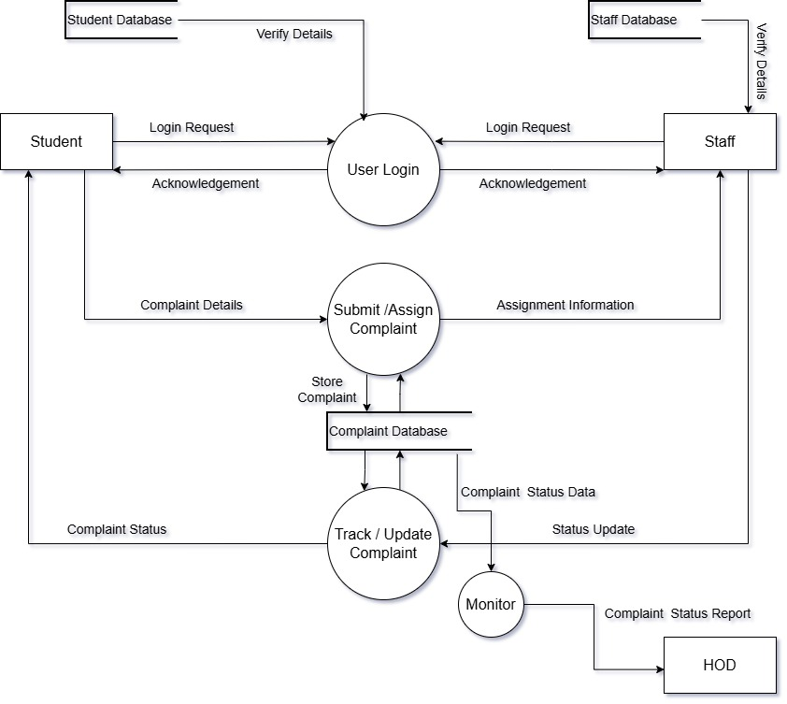
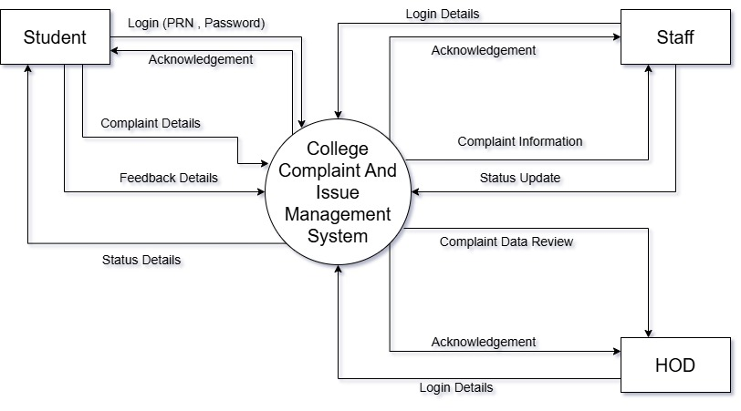
Data Flow Diagram (DFD)
Level 1 DFD
Level 0 DFD

Slide 16
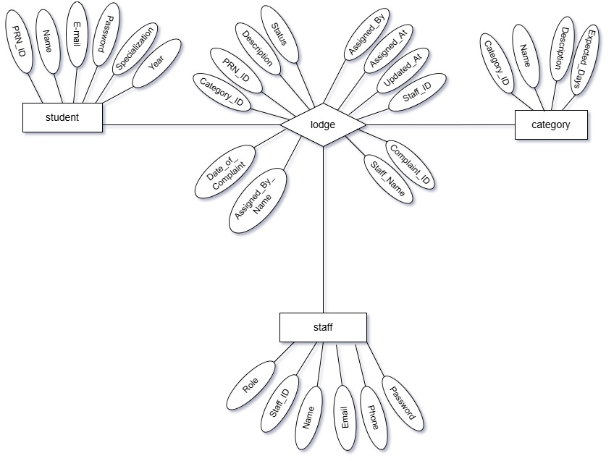
E-R Diagram

Slide 17
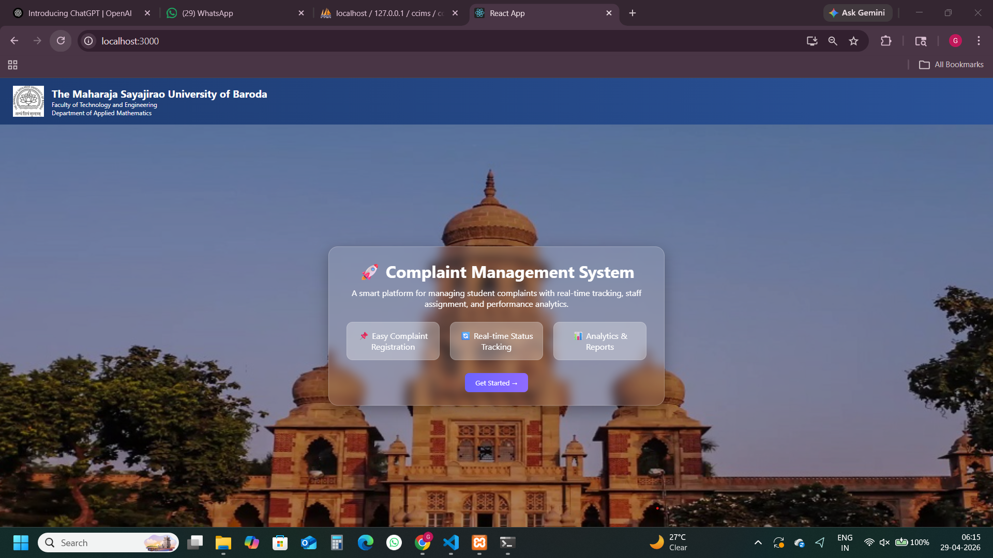
College Complaint & Issue Management System
Output Screens – Home Page
The Maharaja Sayajirao University of Baroda | April 2026

Slide 18
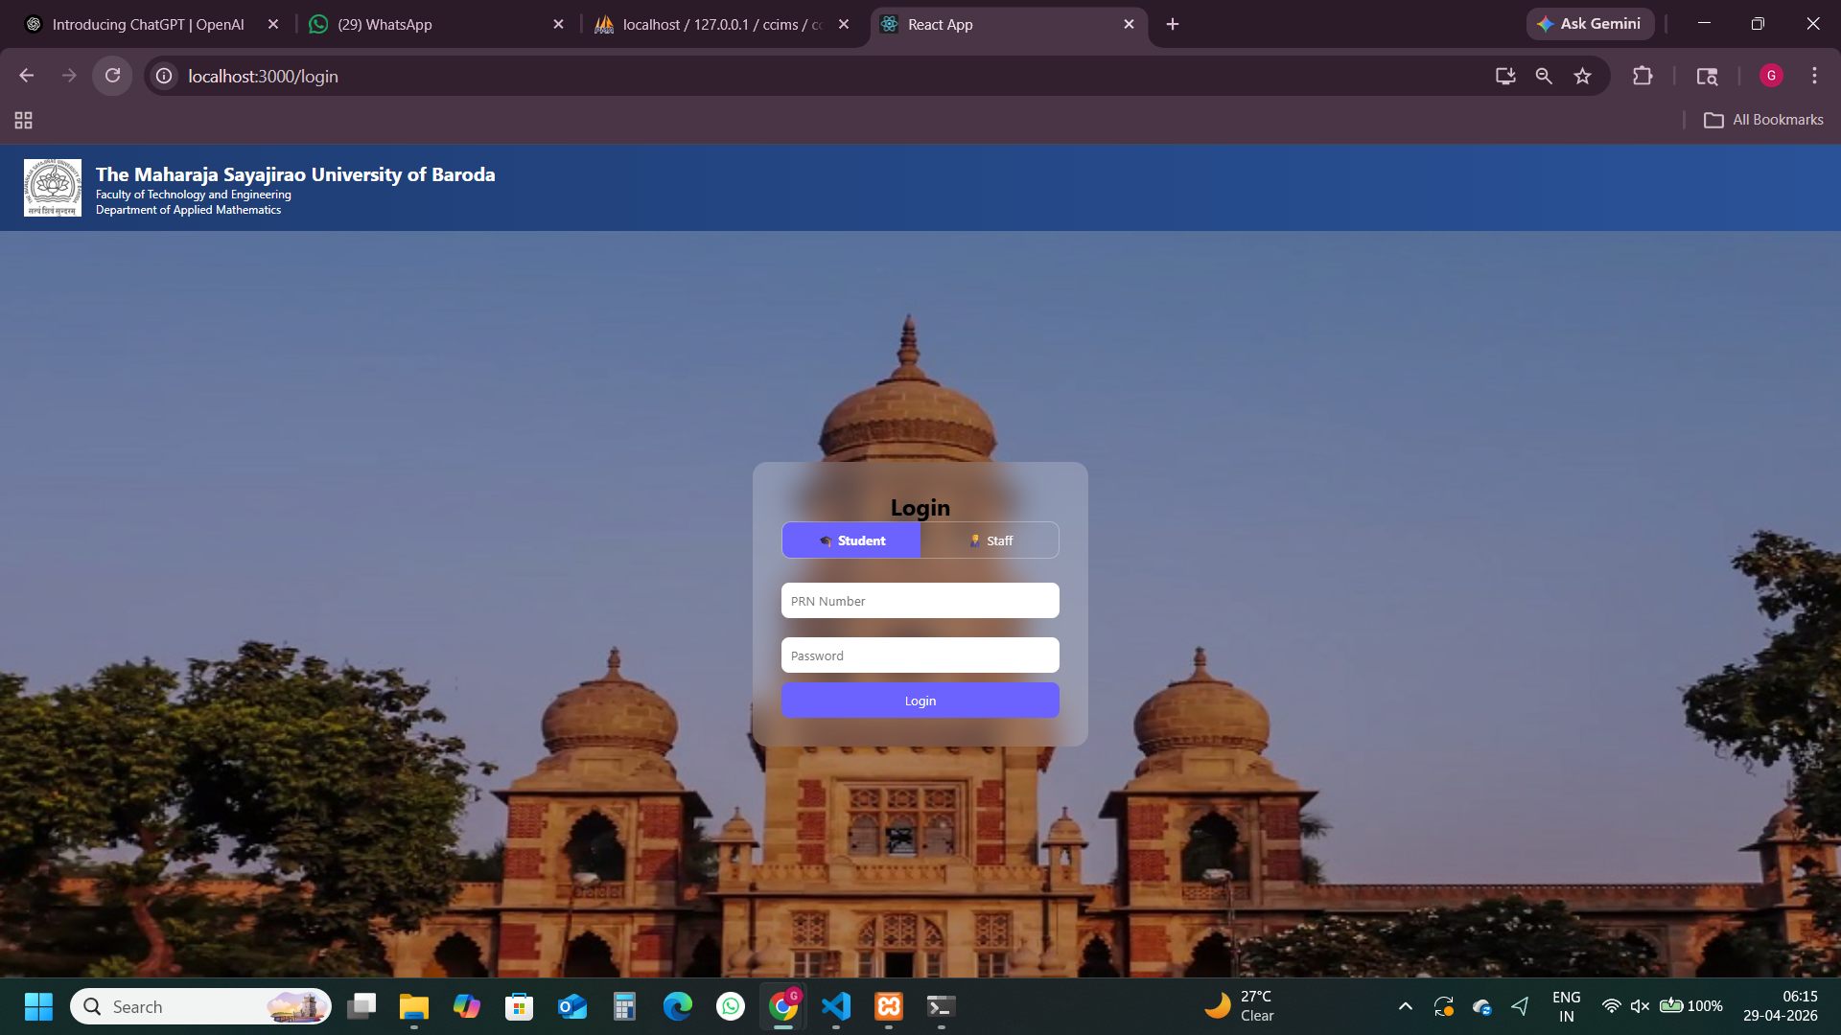
College Complaint & Issue Management System
Output Screens – Student Login
The Maharaja Sayajirao University of Baroda | April 2026

Slide 19
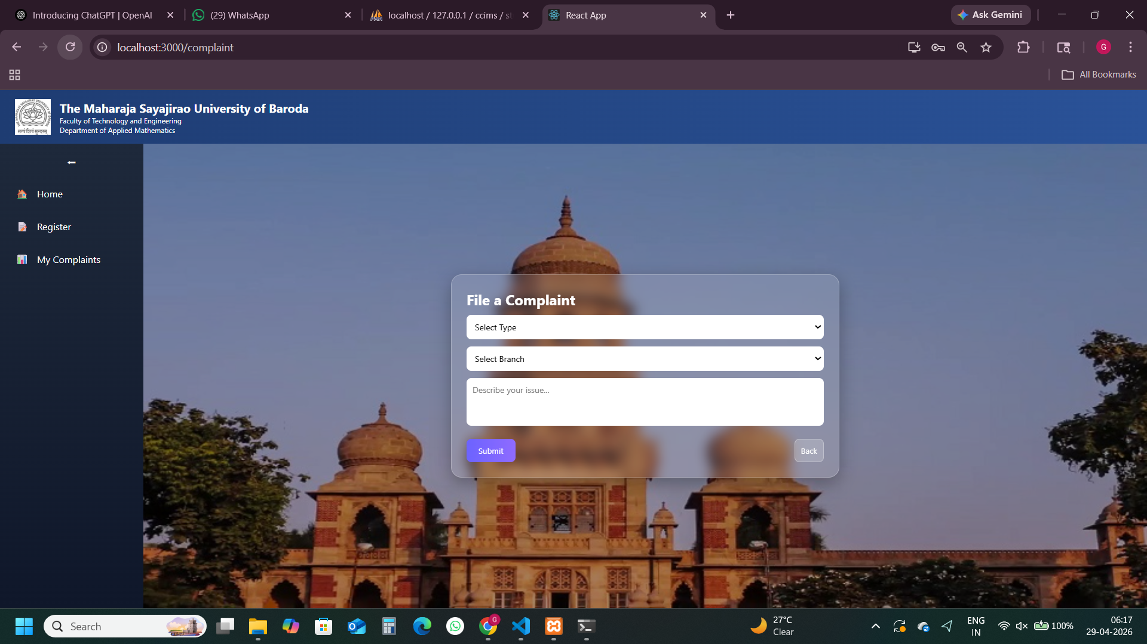
College Complaint & Issue Management System
Output Screens - Register
The Maharaja Sayajirao University of Baroda | April 2026

Slide 20
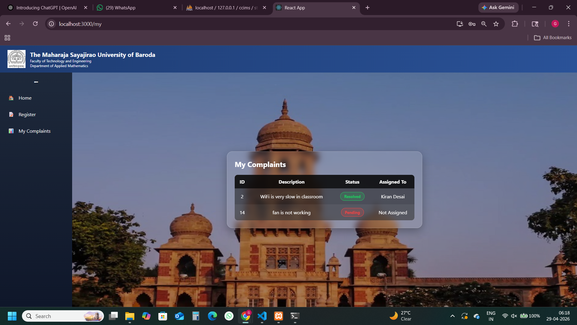
College Complaint & Issue Management System
Output Screens – Student Complaints
The Maharaja Sayajirao University of Baroda | April 2026

Slide 21
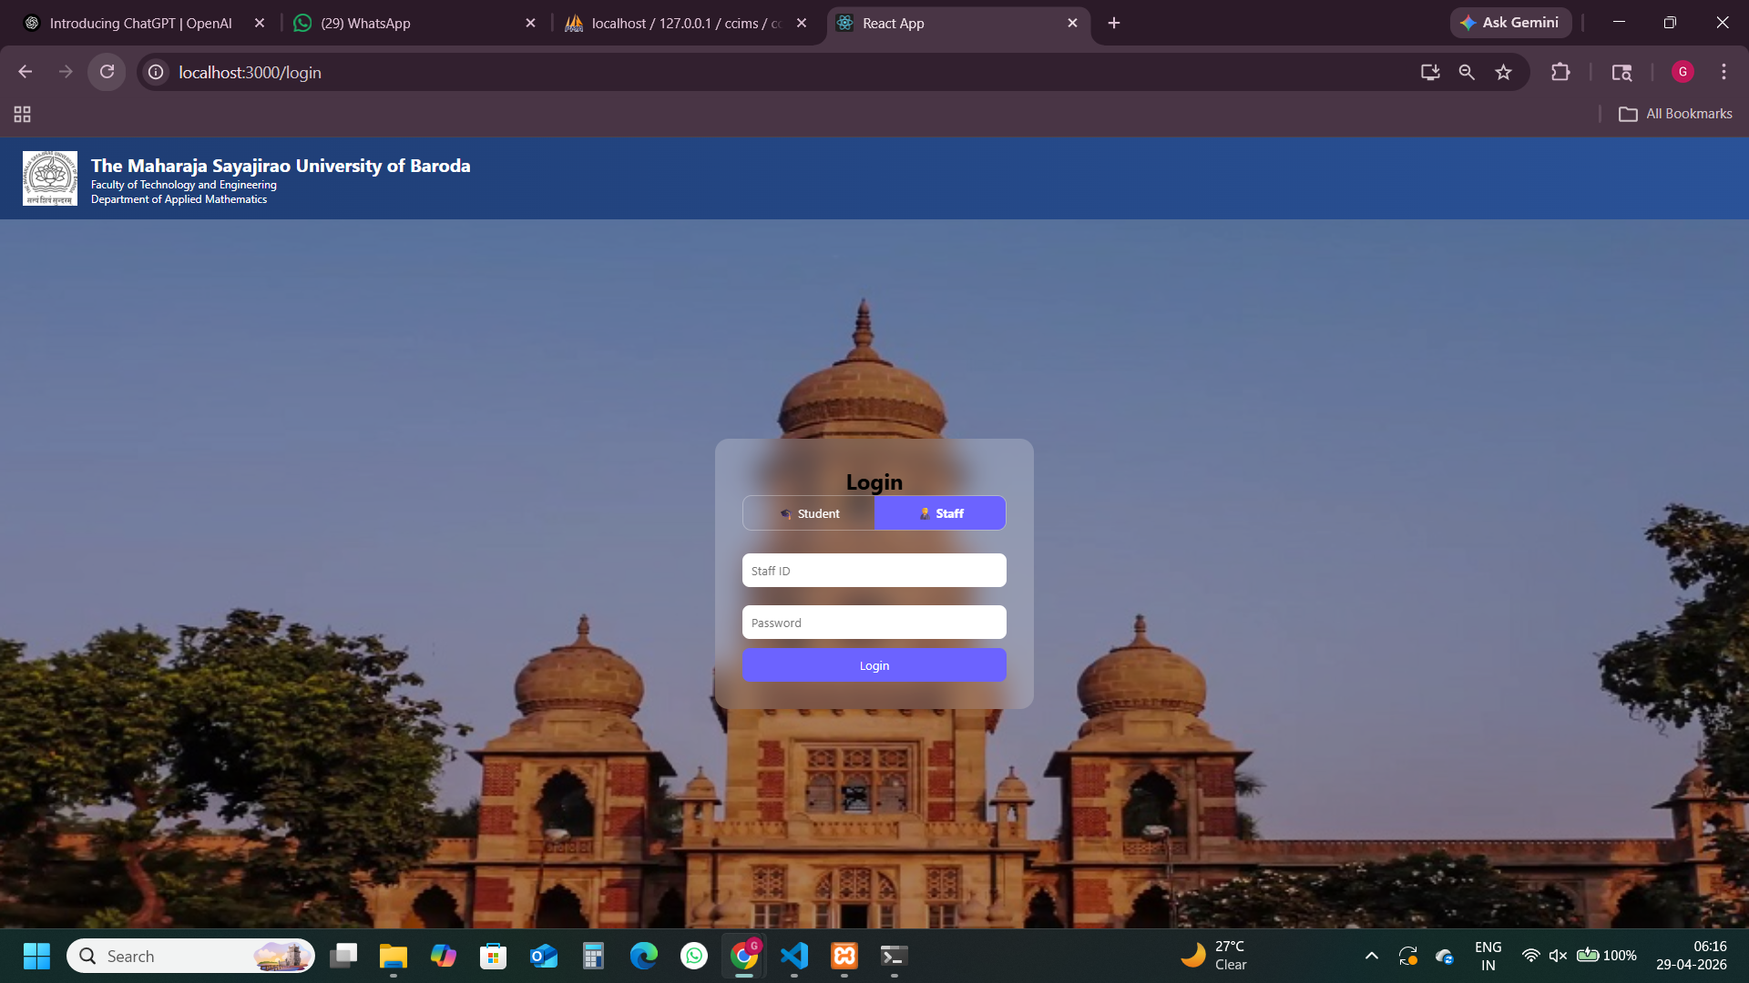
College Complaint & Issue Management System
Output Screens – Staff Login
The Maharaja Sayajirao University of Baroda | April 2026

Slide 22
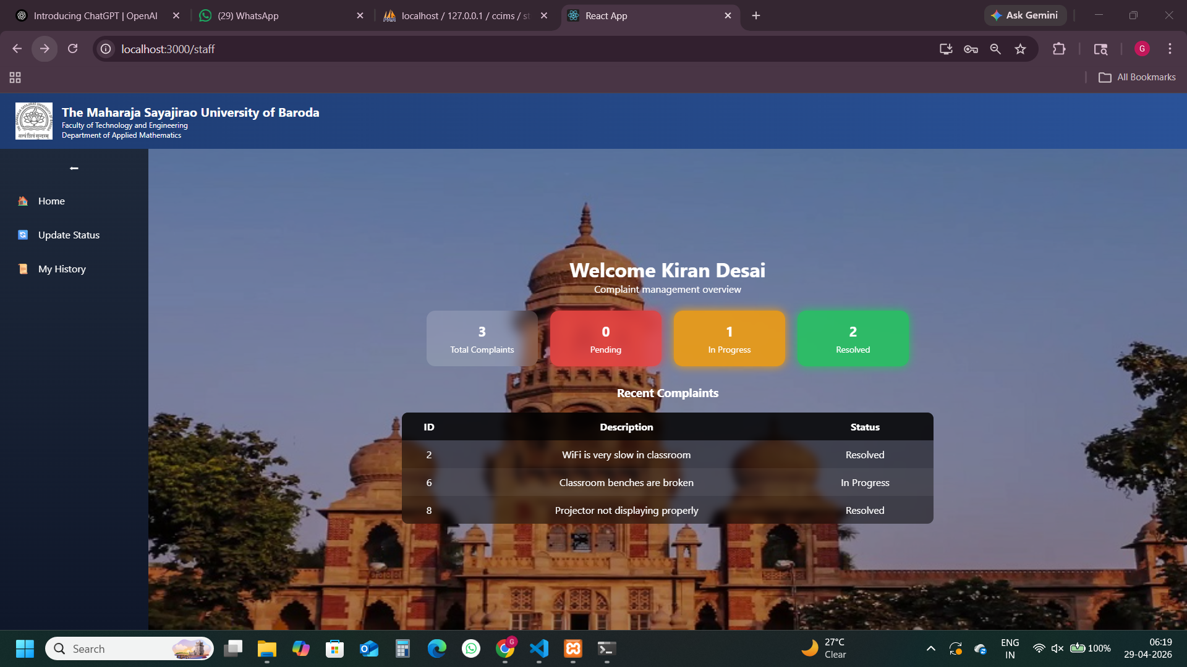
College Complaint & Issue Management System
Output Screens – Staff Dashboard
The Maharaja Sayajirao University of Baroda | April 2026

Slide 23
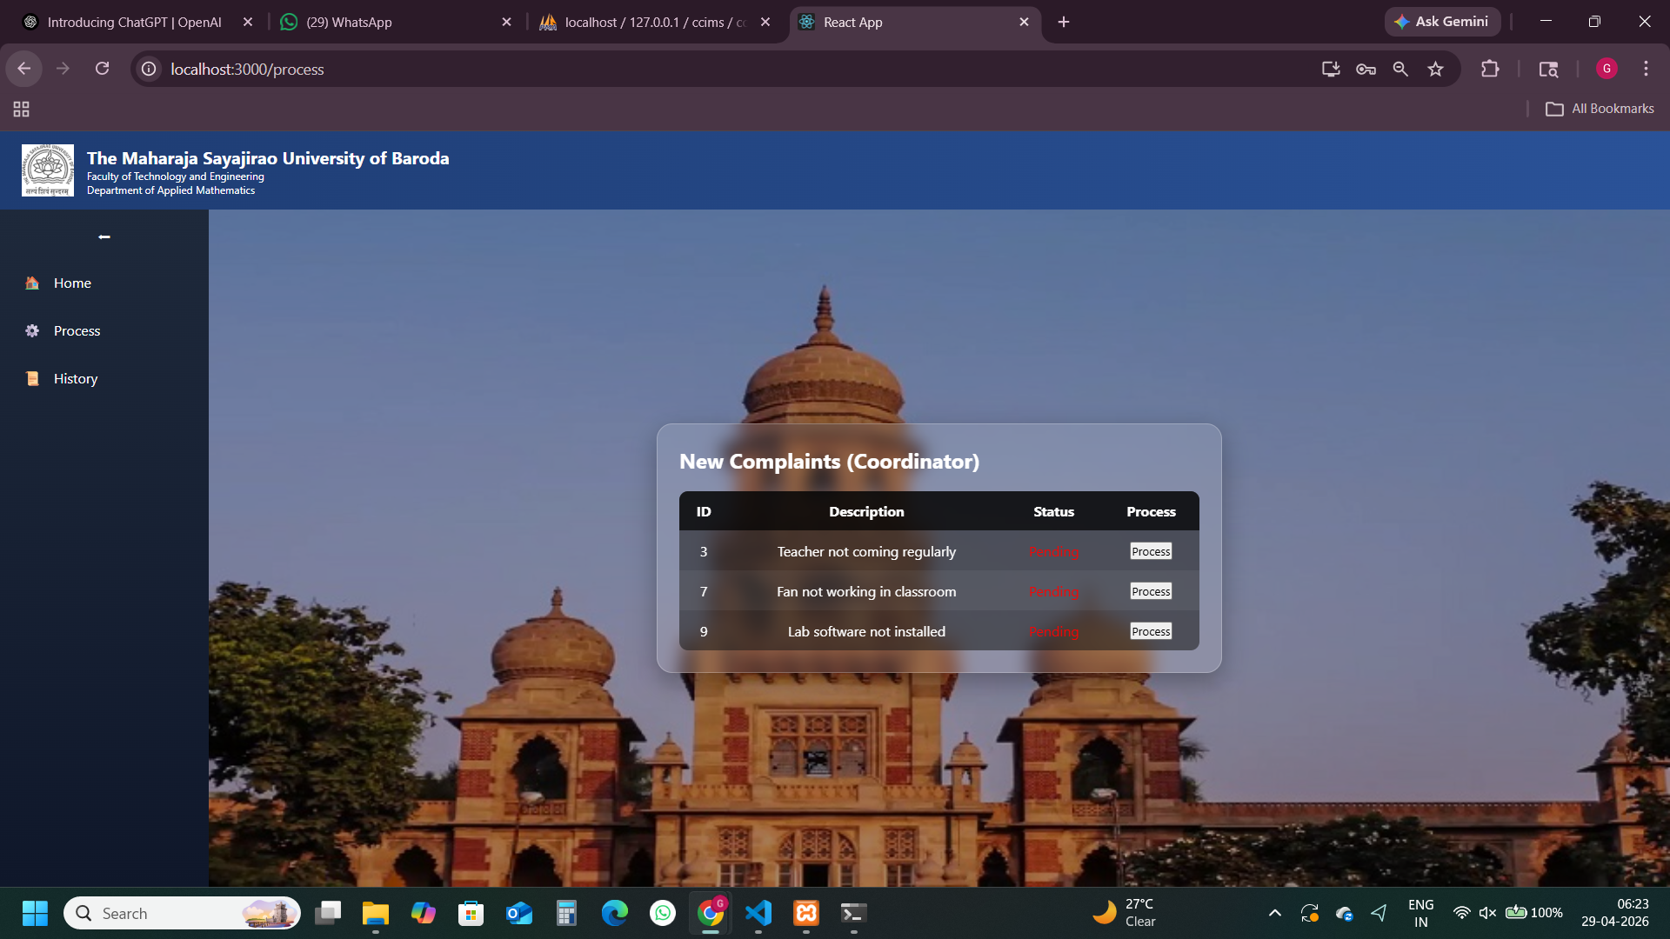
College Complaint & Issue Management System
Output Screens – Coordinator Process
The Maharaja Sayajirao University of Baroda | April 2026

Slide 24
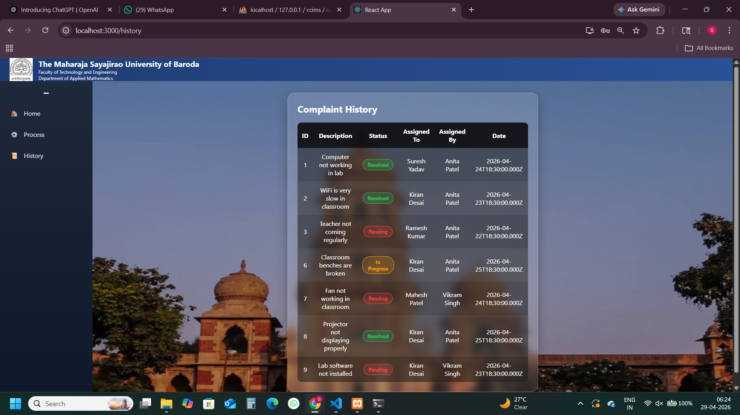
College Complaint & Issue Management System
Output Screens – Coordinator History
The Maharaja Sayajirao University of Baroda | April 2026

Slide 25
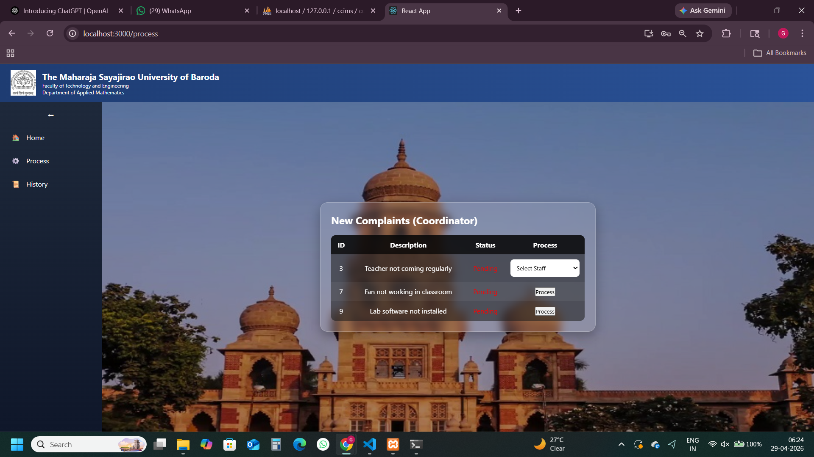
College Complaint & Issue Management System
Output Screens – Staff List of Complaints
The Maharaja Sayajirao University of Baroda | April 2026

Slide 26
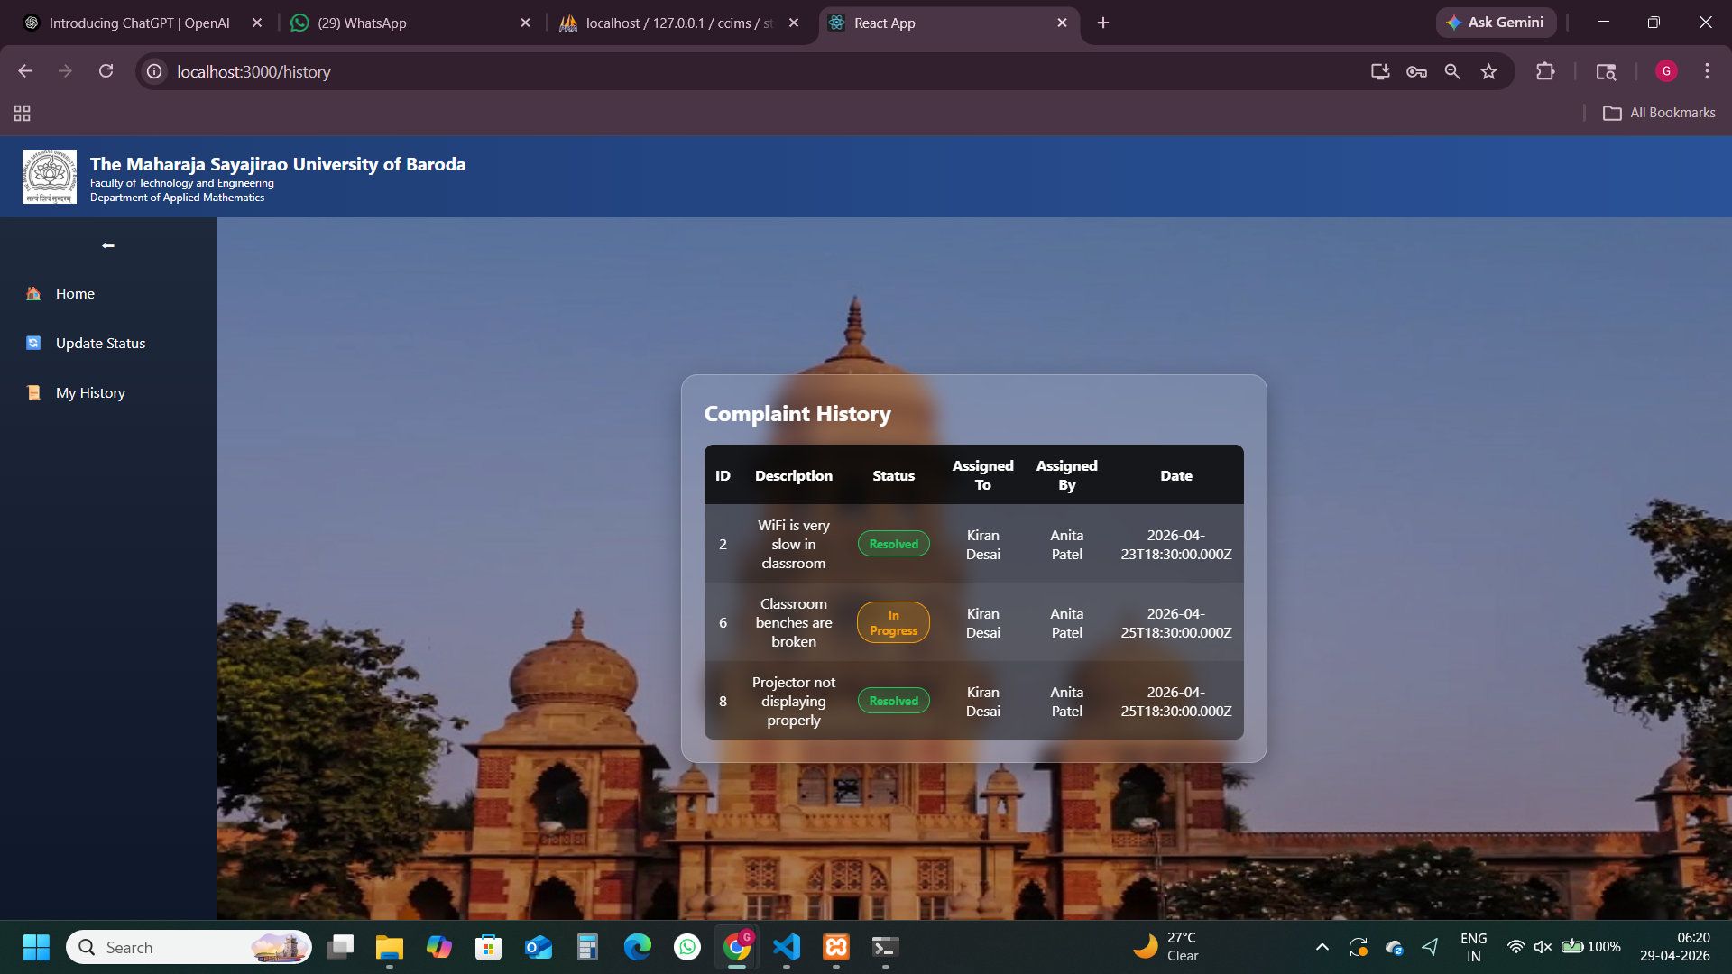
College Complaint & Issue Management System
Output Screens – Staff Complaints
The Maharaja Sayajirao University of Baroda | April 2026

Slide 27
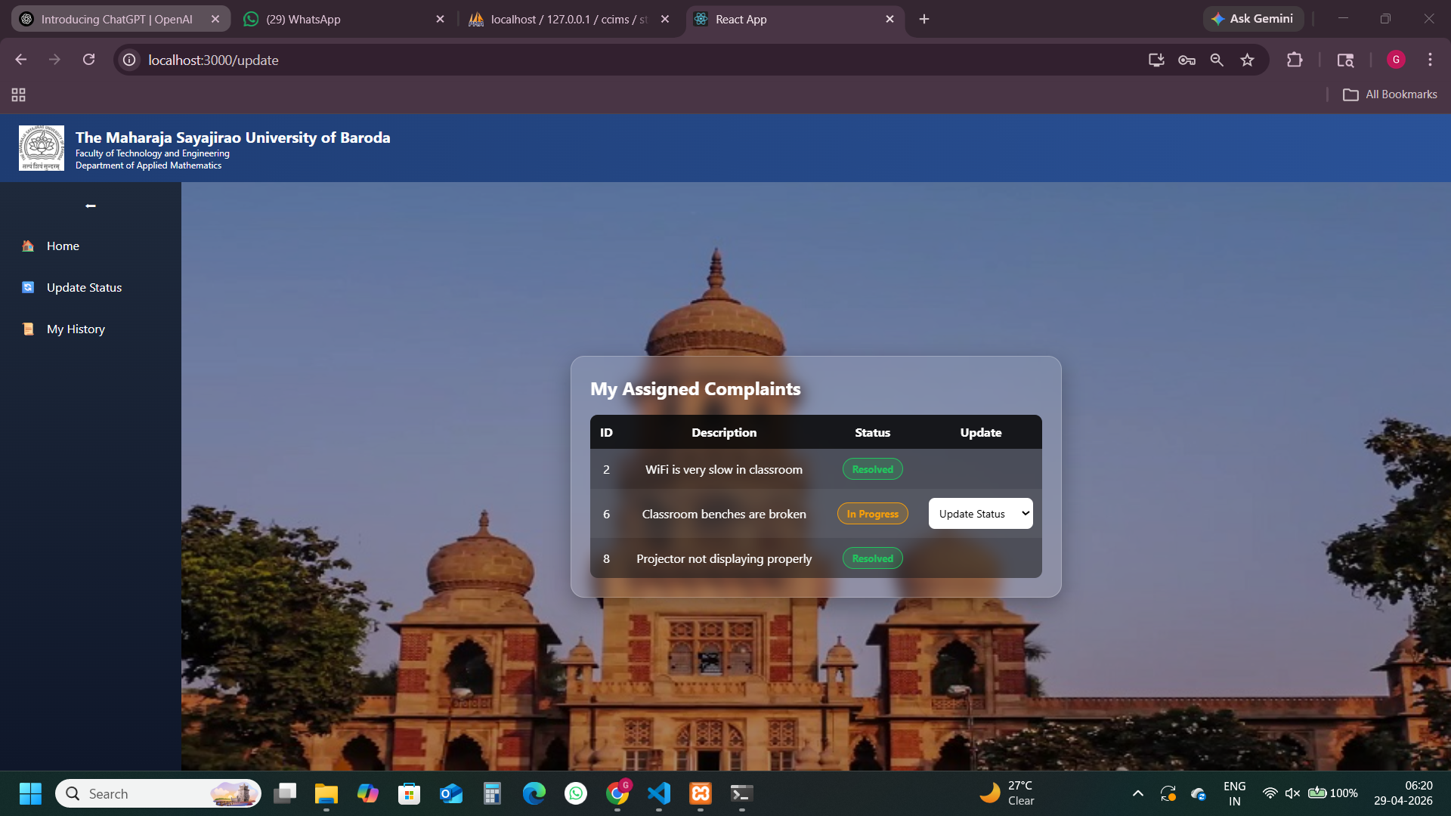
College Complaint & Issue Management System
Output Screens – Update
The Maharaja Sayajirao University of Baroda | April 2026

Slide 28
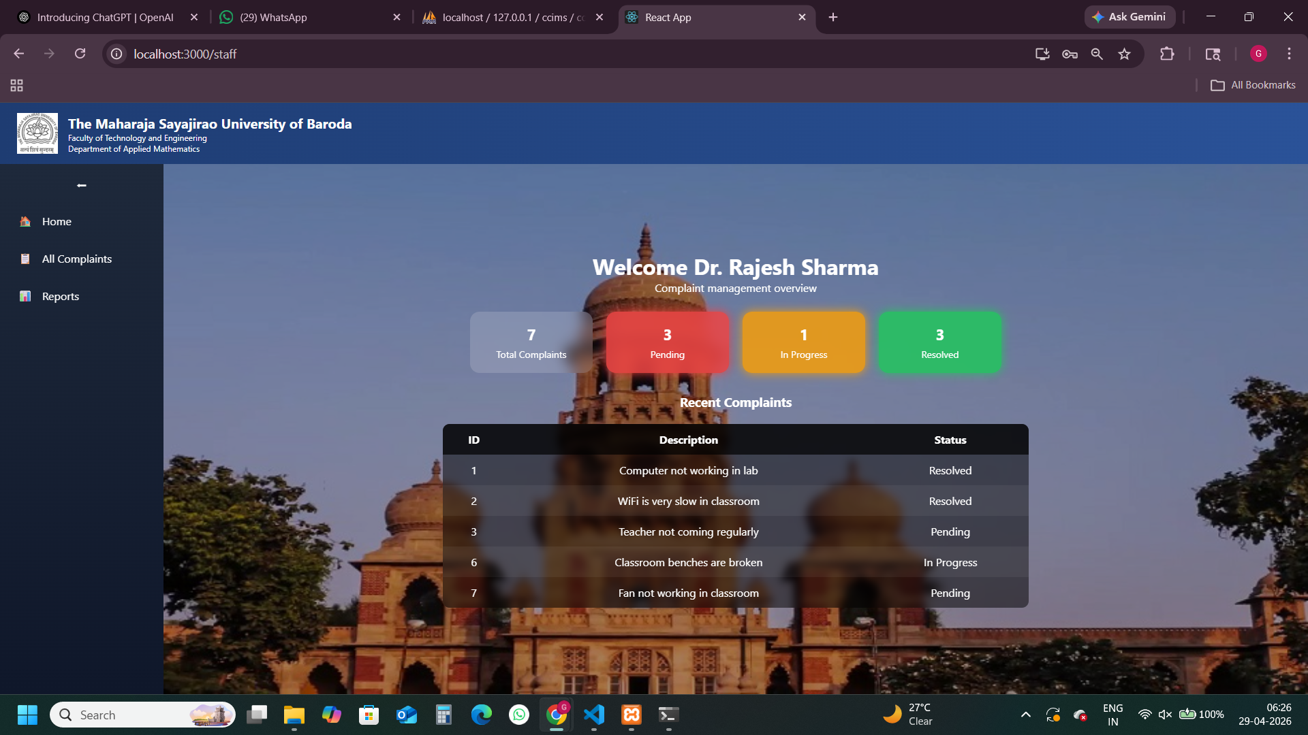
College Complaint & Issue Management System
Output Screens – HOD Dashboard
The Maharaja Sayajirao University of Baroda | April 2026

Slide 29
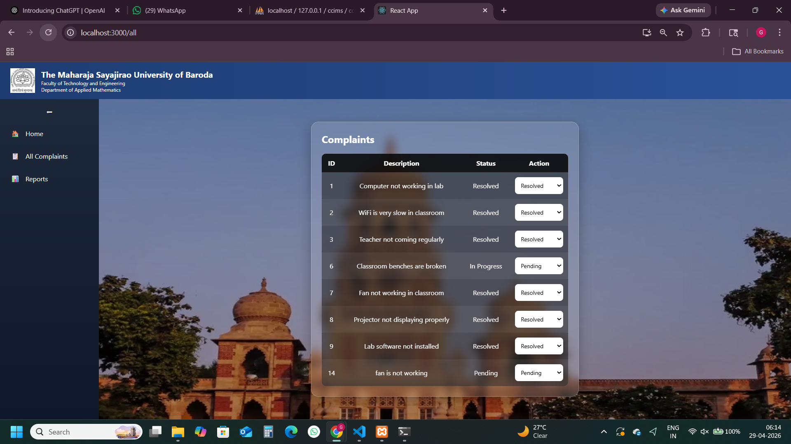
College Complaint & Issue Management System
Output Screens – HOD Page
The Maharaja Sayajirao University of Baroda | April 2026

Slide 30
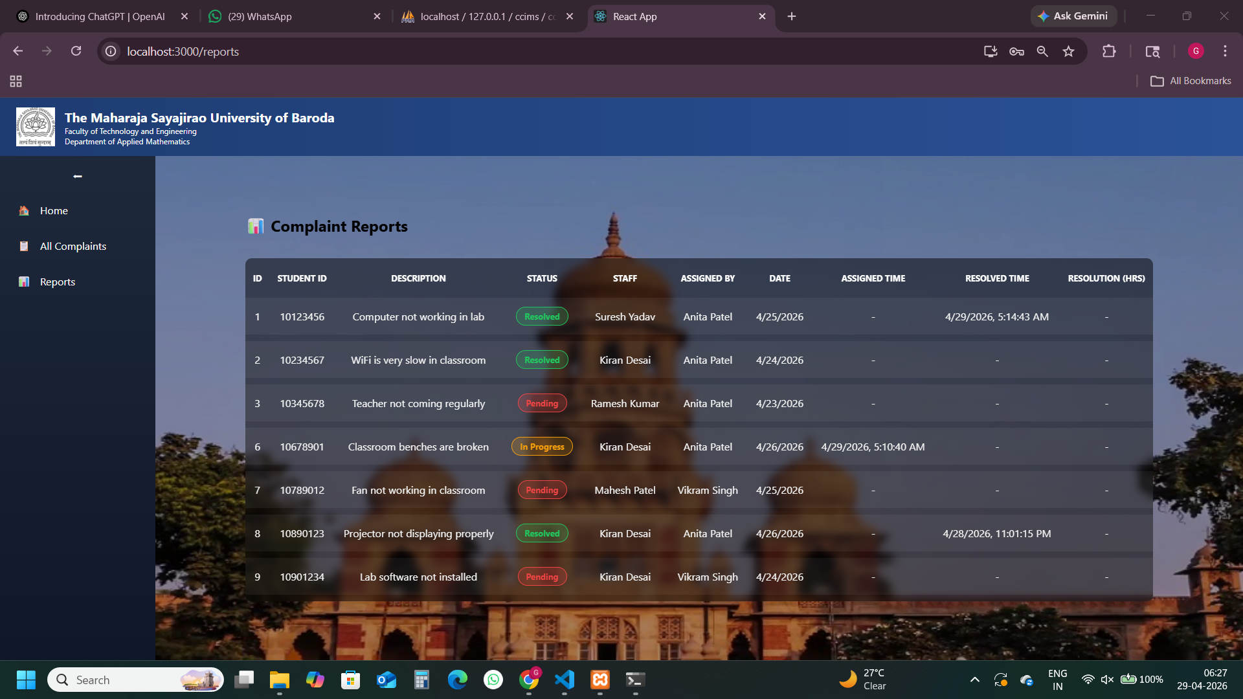
College Complaint & Issue Management System
Output Screens - Reports
The Maharaja Sayajirao University of Baroda | April 2026

Slide 31
College Complaint & Issue Management System
References
https://www.w3schools.com/
https://nodejs.org/en/docs
https://expressjs.com/en/guide
https://react.dev/learn
The Maharaja Sayajirao University of Baroda | April 2026

Slide 32
College Complaint & Issue Management System
Thank You
The Maharaja Sayajirao University of Baroda | April 2026

